Slide 1
Algorithm analysis
The term "analysis of algorithms" was coined by Donald Knuth.
Analysis of algorithm is the process of analyzing the problem-solving capability of the algorithm in terms of the time and size required (the size of memory for storage while implementation).
Analysis of algorithms is the determination of the amount of time and space resources required to an algorithm.

Slide 2
Design and Analysis of Algorithm
Measuring efficiency of algorithm
Time (How long the algorithm takes (running time)
Space : Memory requirement

Slide 3
Complexity
Time complexity:
How much time it takes to compute
Measured by a function T(N)
Space complexity:
How much memory it takes to compute
Measured by a function S(N)

Slide 4
Time taken by an algorithm?
Performance measurement or Apostoriori Analysis- Implementing the algorithm in a machine and then calculating the time taken by the system to execute the program successfully.
Performance Evaluation or Apriori Analysis- Before implementing the algorithm in a system.
1. How long the algorithm takes :-will be represented as a function of the size of the input. f(n)→how long it takes if ‘n’ is the size of input.
2. How fast the function that characterizes the running time grows with the input size. “Rate of growth of running time”. The algorithm with less rate of growth of running time is considered better.

Slide 5
Time complexity
N = Size of the input
T(N) = Time complexity function
Order of magnitude:
How rapidly T(N) grows when N grows
For example: O(N) O(logN) O(N²) O(2^{N})

Slide 6
Defining “problem size”
Typically, it is straightforward to identify the size of a problem, e.g.:
size of array
size of stack, queue, list etc.
vertices and edges in a graph

Slide 7
Analyzing the Algorithm - 1
Algorithm swap(a,b)
{
temp = a;
a = b;
b = temp;
}
Analysis: Time T(n) & Space S(n)

Slide 8
Analysis of Algorithm -1
Assume each simple statement takes 1 unit of time.
Time Complexity
T(n) = O(1)
Algorithm swap(a, b)
# operations
temp = a 1
a = b 1
b = temp 1
Total 3

Slide 9
Analysis of Algorithm -1
Space Complexity
Assume each identifiers of 1 word.
Variables used : a, b, temp = 3
S(n) = O(1)
Algorithm swap(a, b)
temp = a
a = b
b = temp

Slide 10
Algorithm – 2 (Adding the Elements of an Array)
Algorithm sum (A, n)
s = 0
for(i=0;i<n;i++)
s = s + A[i]
return s

Slide 11
Algorithm – 2 (Adding the elements of an array)
Algorithm sum (A, n) #ofOperations
s = 0 1
for(i=0;i<n;i++) (1+n+1+n) = 2n+2 = n+1 s = s + A[i] n
return s 1
Total, T(n) = 2n+3
O(n)

Slide 12
Algorithm – 2 (Adding the elements of an array)
Algorithm sum (A, n)
s = 0
for(i=0;i<n;i++)
s = s + A[i]
return s
Space Complexity
Variables- A(n), n(1),s(1),i(1).
Total, S(n) = n+3=>O(n)

Slide 13
Algorithm – 3 (Sum of Two Matrices)
Algorithm Sum(A,B,n)
for(i=0,i<n;i++)
for(j=0;j<n;j++)
C[i,j] = A[i,j] + B[i,j]

Slide 14
Algorithm – 3 (Sum of Two Matrices)
Algorithm Sum(A,B,n) #of Operations
for(i=0,i<n;i++) n+1
for(j=0;j<n;j++) n*(n+1)
C[i,j] = A[i,j] + B[i,j] n*n
Total, T(n) = 2n² + 2n + 1 => O(n²)

Slide 15
Algorithm – 4 (Multiplication of Two Matrices)
Algorithm multiply(A,B,n)
for(i=0,i<n;i++)
for(j=0;j<n;j++)
C[i,j] = 0
for(k-0;k<n;k++)
C[i,j] = C[i,j] + A[i,k]*B[k,j]

Slide 16
Algorithm – 4 (Multiplication of Two Matrices)
Algorithm multiply(A,B,n) #ofOperations
for(i=0,i<n;i++) n+1
for(j=0;j<n;j++) n*(n+1)
C[i,j] = 0 n*n
for(k-0;k<n;k++) n*n*(n+1)
C[i,j] = C[i,j] + A[i,k]*B[k,j] n*n*n
Total, T(n) = 2n³+3n²+2n+1 => O(n³)

Slide 17
Algorithm – 4 (Multiplication of Two Matrices)
Algorithm multiply(A,B,n)
for(i=0,i<n;i++)
for(j=0;j<n;j++)
C[i,j] = 0
for(k-0;k<n;k++)
C[i,j] = C[i,j] + A[i,k]*B[k,j]
Space Complexity –
A(n*n), B(n*n), C(n*n), n(1),i(1), j(1), k(1).
Total, S(n) = 3n²+3 = > O(n²)

Slide 18
Algorithm 5 (while loop)
# of Operations
i=0; 1
while(I < n) n+1
stmt; n
i++; n
Total 3n+2 => O(n)

Slide 19
Algorithm 5 (while loop)
# of Operations
i=0; 1
while(I < n) n+1
stmt; n
i++; n
Total 3n+2 => O(n)

Slide 20
Algorithm 5 (while loop)
# of Operations
i=0;
while(I < n)
stmt;
i++;

Slide 21
Algorithm 5 (while loop)
# of Operations
i=0; 1
while(I < n)
stmt;
i++;

Slide 22
Algorithm 5 (while loop)
# of Operations
i=0; 1
while(I < n) n+1
stmt;
i++;

Slide 23
Algorithm 5 (while loop)
# of Operations
i=0; 1
while(I < n) n+1
stmt; n
i++; n
Total 3n+2

Slide 24
Algorithm 5 (while loop)
# of Operations
i=0; 1
while(I < n) n+1
stmt; n
i++; n
Total 3n+2 =>O(n)

Slide 25
Algorithm 6 (if-else)
Algorithm test (n) #ofOperations
{
if(n<5)
{
printf(“%d”,n); 1
}
else{
for(i=0;i<n;i++)
{
pri ntf(“%d”,i); n
}
}
} max(1,n) = n =>O(n)

Slide 26
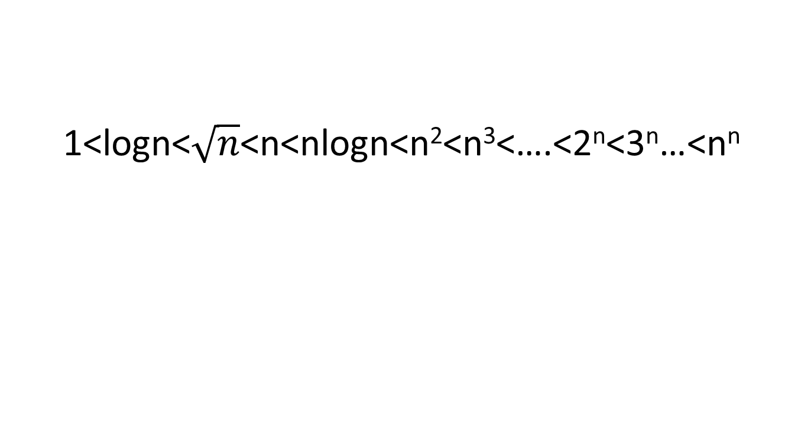
To be remembered
1<logn<$\sqrt{n}$<n<nlogn<n²<n³<….<2^{n}<3^{n}…<n^{n}

Slide 27
Time Analysis
Provides upper and lower bounds of running time.
Different types of analysis:
- Worst case
- Best case
- Average case

Slide 28
Worst Case
Provides an upper bound on running time.
An absolute guarantee that the algorithm would not run longer, no matter what the inputs are.

Slide 29
Best Case
Provides a lower bound on running time.
Input is the one for which the algorithm runs the fastest.

Slide 30
Average Case
Provides an estimate of “average” running time.
Assumes that the input is random.
Useful when best/worst cases do not happen very often (i.e., few input cases lead to best/worst cases).

Slide 31
Comparing algorithms
Given two algorithms having running times f(n) and g(n), how do we decide which one is faster?
Compare “rates of growth” of f(n) and g(n)

Slide 32
Understanding Rate of Growth
Consider the example of buying elephants and fish:
Cost: (cost_of_elephants) + (cost_of_fish)
Approximation:
Cost ~ cost_of_elephants

Slide 33
Understanding Rate of Growth (cont’d)
The low order terms of a function are relatively insignificant for large n
n⁴ + 100n² + 10n + 50
Approximation:
n⁴
Highest order term determines rate of growth!

Slide 34
Example
Suppose you are designing a website to process user data (e.g., financial records).
Suppose program A takes f_{A}(n)=30n+8 microseconds to process any n records, while program B takes f_{B}(n)=n²+1 microseconds to process the n records.
Which program would you choose, knowing you’ll want to support millions of users?

Slide 35
Example
Suppose you are designing a website to process user data (e.g., financial records).
Suppose program A takes f_{A}(n)=30n+8 microseconds to process any n records, while program B takes f_{B}(n)=n²+1 microseconds to process the n records.
Which program would you choose, knowing you’ll want to support millions of users?
A
Compare rates of growth:
30n+8 ~ n and n²+1 ~ n²

Slide 36
Growth Function
Order of growth of functions provides a simple characterization of efficiency
Allows for comparison of relative performance between alternative algorithms
Concerned with asymptotic efficiency of algorithms
Best asymptotic efficiency usually is best choice except for smaller inputs
Several standard methods to simplify asymptotic analysis of algorithms

Slide 37
Asymptotic Analysis
Study of change in performance of the algorithm with the change in the order of the input size is defined as asymptotic analysis.

Slide 38
Asymptotic Notations
Mathematical notations used to describe the running time of an algorithm when the input tends towards a particular value or a limiting value.

Slide 39
Asymptotic Notation
O notation: asymptotic “less than”: Upper Bound f(n)=O(g(n)) implies: f(n) “≤” g(n)
Ω notation: asymptotic “greater than”: Lower Bound
f(n)= Ω (g(n)) implies: f(n) “≥” g(n)
Θ notation: asymptotic “equality”: Average/Tight Bound
f(n)= Θ (g(n)) implies: f(n) “=” g(n)

Slide 40
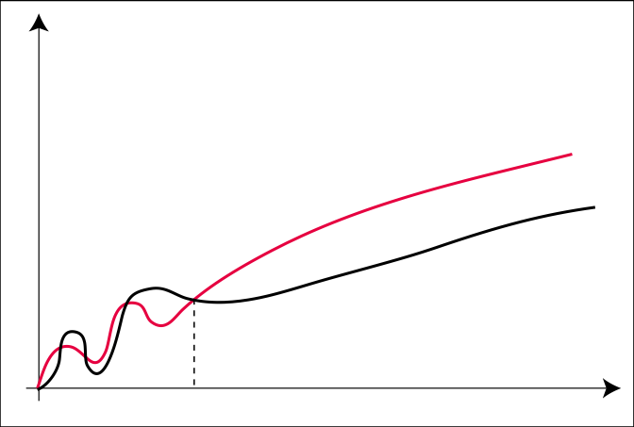
The O-Notation (Upper Bound)
O(g(n)) = { f(n) : ∃c > 0, n₀ > 0 s.t. ∀n ≥ n₀: f(n) ≤ c ⋅ g(n) }
c ⋅ g
f
n₀

Slide 41
Asymptotic O Notation
O notation: asymptotic “less than”:
f(n)=O(g(n)) implies: f(n) “≤” c g(n) in the limit*
c is a constant
(used in worst-case analysis)
*formal definition in CS477/677

Slide 42
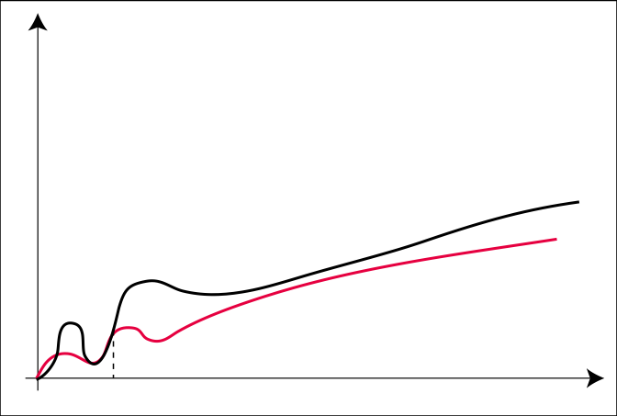
The Ω-Notation (Lower Bound)
Ω(g(n)) = { f(n) : ∃c > 0, n₀ > 0 s.t. ∀n ≥ n₀: f(n) ≥ c ⋅ g(n) }
f
c ⋅ g
n₀

Slide 43
Asymptotic Notation
Ω notation: asymptotic “greater than”:
f(n)= Ω (g(n)) implies: f(n) “≥” c g(n) in the limit*
c is a constant
(used in best-case analysis)
*formal definition in CS477/677

Slide 44
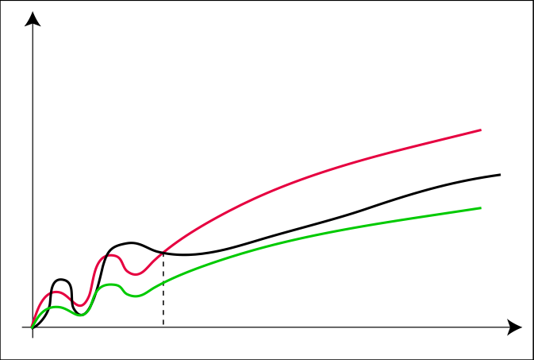
The Θ-Notation (Average Bound)
Θ(g(n)) = { f(n) : ∃c₁, c₂ > 0, n₀ > 0 s.t. ∀n ≥ n₀: c₁ · g(n) ≤ f(n) ≤ c₂ ⋅ g(n) }
c₂ ⋅ g
f
c₁ ⋅ g
n₀

Slide 45
Asymptotic Θ Notation (Average Bound)
Θ notation: asymptotic “equality”:
f(n)= Θ (g(n)) implies: f(n) “=” c g(n) in the limit*
c is a constant
(provides a tight bound of running time)
(best and worst cases are same)
*formal definition in CS477/677

Slide 46
Big-O Notation - Examples
f_{A}(n)=30n+8
f_{B}(n)=n²+1
10n³ + 2n²
n³ - n²
1273

Slide 47
Big-O Notation - Examples
f_{A}(n)=30n+8
f_{B}(n)=n²+1
10n³ + 2n²
n³ - n²
1273
is O(n)
is O(n²)
is O(n³)
is O(n³)
is O(1)

Slide 48
Things to Remember
Asymptotic analysis studies how the values of functions compare as their arguments grow without bounds.
Ignores constants and the behavior of the function for small arguments.
Acceptable because all algorithms are fast for small inputs and growth of running time is more important than constant factors.

Slide 49
Things to Remember
Ignoring the usually unimportant details, we obtain a representation that succinctly describes the growth of a function as its argument grows and thus allows us to make comparisons between algorithms in terms of their efficiency.

Slide 50
Analyzing Linear Search Algorithm
Operations to count: how many times Num is compared to member of array
One after the loop each time plus ...
Best-case: find the number we are looking for at the first position in the array (1 = comparisons) O(1)
Average-case: find the number on average half-way down the array (sometimes longer, sometimes shorter)
(N/2+1 comparisons) O(N)
Worst-case: have to compare Num to very element in the array (N comparisons) O(N)

Slide 51
Search Algorithm : Binary Search
int search(int A[], int N, int Num) {
int first = 0;
int last = N - 1;
int mid = (first + last) / 2;
while ((A[mid] != Num) && (first <= last)) {
if (A[mid] > Num)
last = mid - 1;
else
first = mid + 1;
mid = (first + last) / 2;
}
if (A[mid] == Num)
return mid;
else
return -1;
}

Slide 52
Analyzing Binary Search
One comparison after loop
First time through loop, toss half of array
Second time, half remainder (1/4 original)
Third time, half remainder (1/8 original)
…
Loop Iteration Remaining Elements
1 N/2
2 N/4
3 N/8
4 N/16
…
?? 1
How long to get to 1?

Slide 53
Analyzing Binary Search (Contd.)
•The amount of work done before and after the loop is a constant, and independent of n
•The amount of work done during a single execution of the loop is constant
•Time complexity will therefore be proportional to number of times the loop is executed, so that’s what we’ll analyze

Slide 54
Analyzing Binary Search (Contd.)
Worst case: key is not found in the array
•Each time through the loop, at least half of the remaining locations are rejected:
•After first time through, <= n/2 remain
•After second time through, <= n/4 remain
•After third time through, <= n/8 remain
•After kth time through, <= n/2^{k} remain

Slide 55
Analyzing Binary Search (Contd.)
2^{k} > n >= 2 ^{k}-1
Next, take base-2 logarithms to get:
k > log2(n) >= k-1
•Which is equivalent to:
log2(n) < k <= log2(n) + 1
•Thus, binary search algorithm is O(log2(n)) in terms of the number of array locations examined

